Slide 1
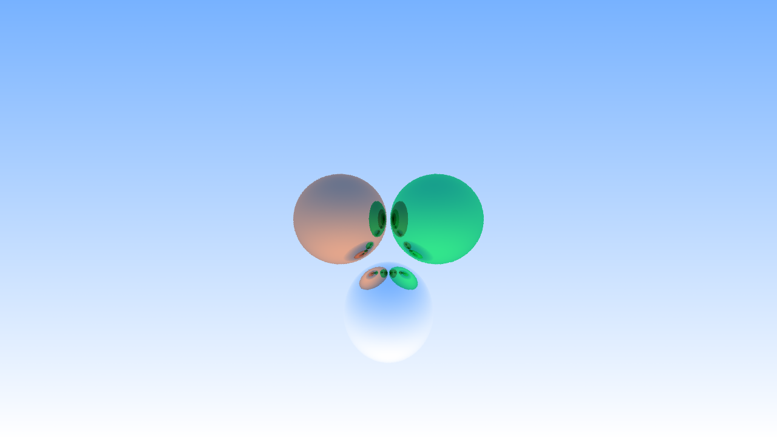
RAY TRACER IN PYTHON
COMPUTER LAB SEMESTER 1 PROJECT
By:
Abhijeet Rajkumar
Ish Bosamiya
Rajdeep Sengupta
Section C

Slide 2
DESCRIPTION OF OUR PROJECT
Simulation of light rays in the virtual 3D world consisting of different 3D models such as Spheres and Triangles with more complex models stored as List of Triangles. Through the concept of vectors and vector equations of different 3D models, intersections are determined and the material properties at the point of intersection are used to determine the further path of the light rays which may have more intersections. The final colour of the light rays is stored per pixel of the final image in the format of PPM.

Slide 3
CONCEPTS USED
Classes in Python
User Defined Functions
Importing functions and classes from other project files
Concepts of vectors, scattering, reflection and more

Slide 4
CLASSES USED
Vec3 - stores vector coordinates and functions for performing vector calculations
Camera - determines the camera to determine the rays that must be cast
Completion_Bar -indicates the progress of the code that has been run along with rough approximation of time remaining
Hitable_List - stores list of Hitable objects and finds the closest intersection
Material - defines the material properties of the object
Lambert - calculates the scattering when rays strike a rough surface
Metal - calculates the scattering when rays strike a glossy surface
Ray - stores the origin and direction of the ray and used to determine the point on the ray for a certain parameter
Sphere - stores center and radius of a sphere and determines if a given ray has intersected with it
Triangle - stores vertices of the triangle and determines if a given ray has intersected with it
Hit_Record - stores different parameters at the point of intersection used by the materials
Model - stores list of triangles read from an obj file and determines ray intersection

Slide 5
Renders

Slide 6
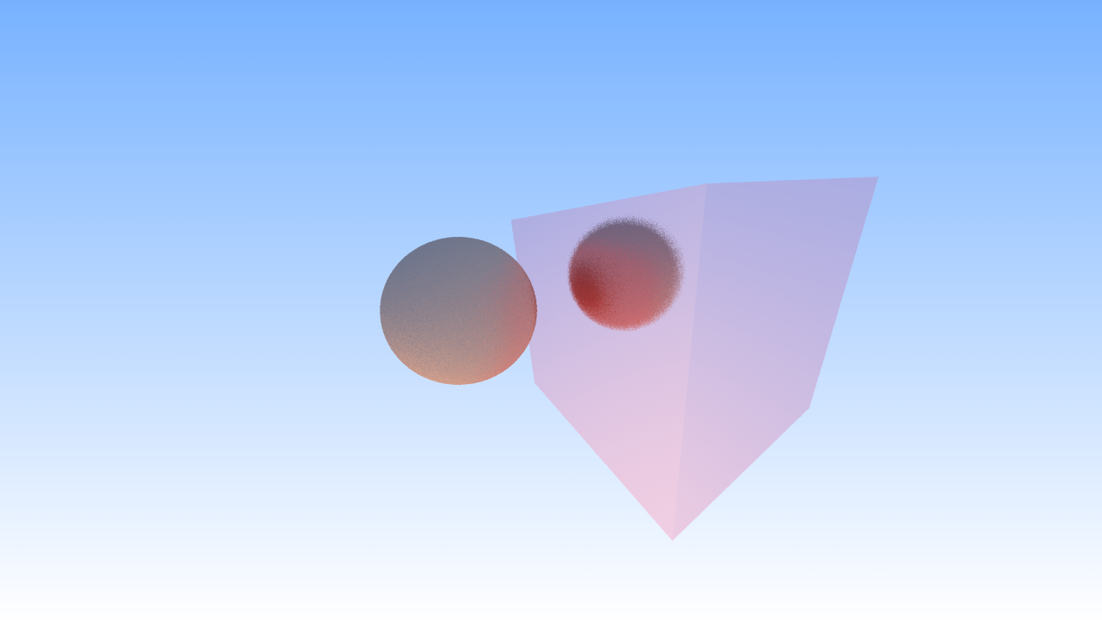

Slide 7
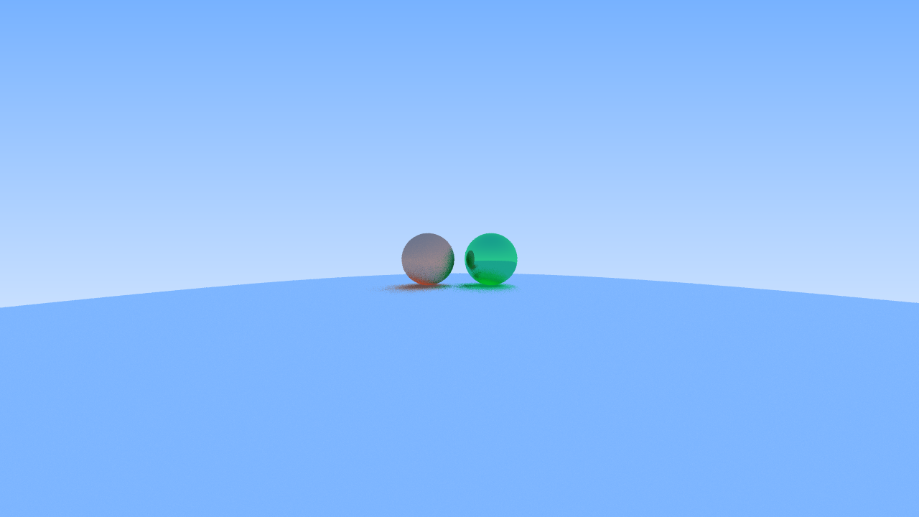

Slide 8
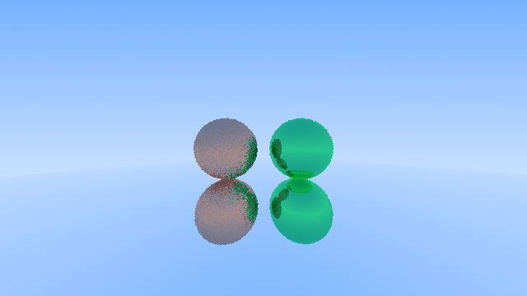

Slide 9
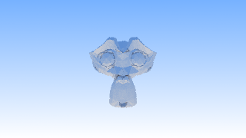

Slide 10
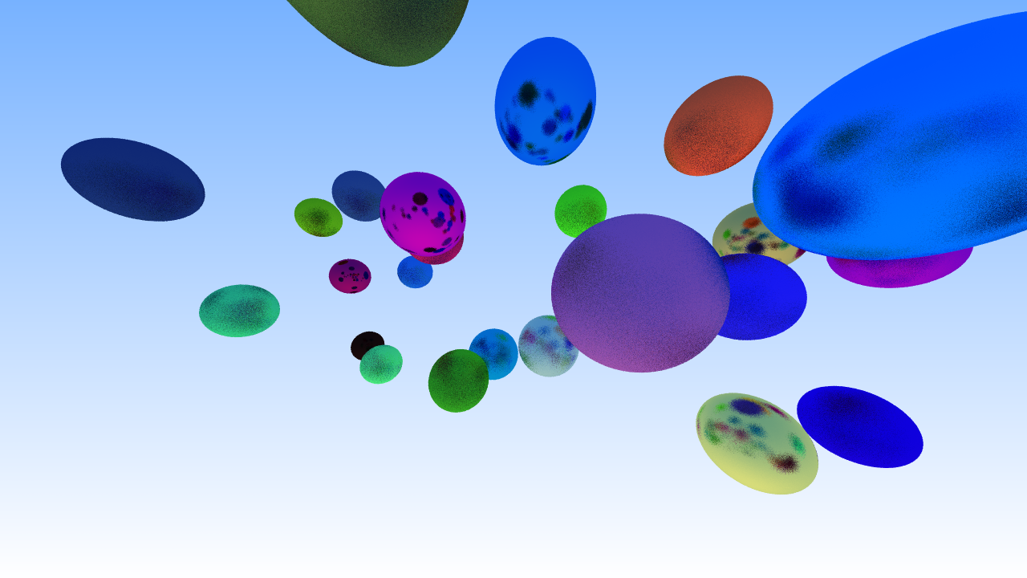

Slide 11
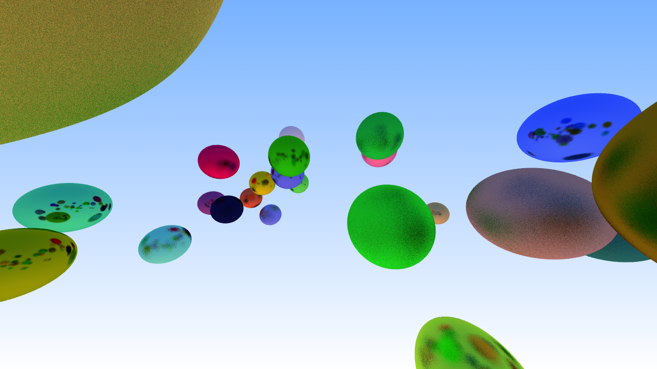

Slide 13
Thank You

